Slide 1

AI-Based Research Paper Novelty Assessment System Using Retrieval-Augmented Generation (RAG)
Major Project Review - 1
Batch ID: AIML-B06
Project Guide
Project Batch Members
Dr . M . Srinivasa Rao
Associate Professor
Department of CSE(AI&ML),VVIT
P. Aishwarya – 23BQ1A61A6.
K. Sai Haneesha – 23BQ1A6171.
K. Harshitha – 23BQ1A6156.
K. Dhanesh Babu– 23BQ1A6158.

Slide 2
AI-Based Research Paper Novelty Assessment System Using Retrieval-Augmented Generation (RAG)
Guide: Dr. M . Srinivasa Rao
Batch ID: AIML-B06
Regd No#1 23BQ1A61A6, Regd No#2 23BQ1A6171,
Regd No#3 23BQ1A6156, Regd No#4 23BQ1A6158,
Problem statement
The rapid growth of scientific publications makes it difficult for researchers to manually evaluate the originality and novelty of a new research paper.
Existing plagiarism and similarity detection tools mainly identify copied or textually similar content, but they do not adequately assess conceptual novelty.
A research paper may use different wording while presenting an existing research idea, methodology, dataset, or contribution.
Researchers therefore need to manually search and compare large amounts of existing literature to determine whether their work provides new contributions or addresses an unexplored research gap.
Current novelty assessment approaches based mainly on citations or textual similarity may not capture the deeper relationship between research ideas.

Slide 3
AI-Based Research Paper Novelty Assessment System Using Retrieval-Augmented Generation (RAG)
Guide: Dr. M . Srinivasa Rao
Batch ID: AIML-B06
Regd No#1 23BQ1A61A6, Regd No#2 23BQ1A6171,
Regd No#3 23BQ1A6156, Regd No#4 23BQ1A6158,
Literature Review
Ref 01 – Evaluating and Enhancing Large Language Models for Novelty Assessment in Scholarly Publications
Ethan Lin et al., 2025 | Workshop on AI and Scientific Discovery (ACL)
| Proposed Method | Data & Setup | key Results | Strengths & Limitations | Relevance to my research |
The paper proposes RAG-Novelty, a retrieval-augmented method that helps LLMs assess the novelty of scholarly research papers using relevant existing literature.
The title, abstract, and available metadata of a research paper are used as the input, with the paper abstract serving as the main query for retrieving related research.
A collection of research papers is converted into embeddings, and a retriever uses cosine similarity to find the most relevant Top-K papers from the indexed corpus.
To make the evaluation realistic, the method applies temporal filtering, so papers published after the query paper are not considered and the query papers themselves are excluded from retrieval.
The retrieved papers are combined with the query paper information and provided to an LLM through a self-reflection-based prompt, allowing the model to assess the paper using additional research context.
Finally, the LLM evaluates and scores the novelty of the query paper from 0 to 10, using the retrieved literature and publication-time information to support its assessment.

Slide 4
AI-Based Research Paper Novelty Assessment System Using Retrieval-Augmented Generation (RAG)
Guide: Dr. M . Srinivasa Rao
Batch ID: AIML-B06
Regd No#1 23BQ1A61A6, Regd No#2 23BQ1A6171,
Regd No#3 23BQ1A6156, Regd No#4 23BQ1A6158,
Literature Review
Ref 01 – Evaluating and Enhancing Large Language Models for Novelty Assessment in Scholarly Publications
Ethan Lin et al., 2025 | Workshop on AI and Scientific Discovery (ACL)
| Proposed Method | Data & Setup | key Results | Strengths & Limitations | Relevance to my research |
The study uses research papers from the arXiv dataset, which contains a large collection of scientific publications.
For the SchNovel benchmark, the authors created 15,000 pairs of research papers from six fields: Computer Science, Mathematics, Physics, Quantitative Biology, Quantitative Finance, and Statistics.
The paired papers have publication-year gaps of 2, 4, 6, 8, and 10 years, and the more recently published paper is considered more novel for evaluation.
For each paper, the LLM is mainly provided with its title, abstract, and optional metadata, instead of the complete paper text, to reduce processing cost and improve efficiency.
For RAG-Novelty, paper abstracts are converted into embeddings using OpenAI text-embedding-3-small, and relevant papers are retrieved using cosine similarity.
The experiments evaluate different LLM-based approaches, with GPT-4o-mini used for the main comparison of RAG-Novelty with other baseline methods.

Slide 5
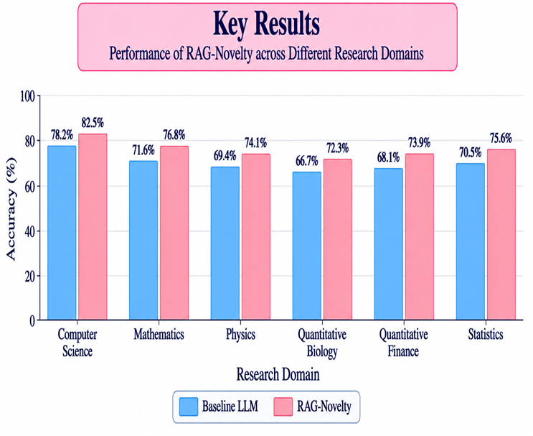
AI-Based Research Paper Novelty Assessment System Using Retrieval-Augmented Generation (RAG)
Guide: Dr. M . Srinivasa Rao
Batch ID: AIML-B06
Regd No#1 23BQ1A61A6, Regd No#2 23BQ1A6171,
Regd No#3 23BQ1A6156, Regd No#4 23BQ1A6158,
Literature Review
Ref 01 – Evaluating and Enhancing Large Language Models for Novelty Assessment in Scholarly Publications
Ethan Lin et al., 2025 | Workshop on AI and Scientific Discovery (ACL)
| Proposed Method | Data & Setup | key Results | Strengths & Limitations | Relevance to my research |
RAG-Novelty achieved the best overall performance among the evaluated baseline methods.
The method showed that retrieving relevant research context improves LLM-based novelty assessment.
Pairwise comparison of research papers performed better than evaluating papers independently.
Performance varied across domains, with Computer Science showing stronger results, while Mathematics and Physics were more challenging.
Publication-year gap and choice of LLM were also found to influence novelty-assessment performance.

Slide 6
AI-Based Research Paper Novelty Assessment System Using Retrieval-Augmented Generation (RAG)
Guide: Dr. M . Srinivasa Rao
Batch ID: AIML-B06
Regd No#1 23BQ1A61A6, Regd No#2 23BQ1A6171,
Regd No#3 23BQ1A6156, Regd No#4 23BQ1A6158,
Literature Review
Ref 01 – Evaluating and Enhancing Large Language Models for Novelty Assessment in Scholarly Publications
Ethan Lin et al., 2025 | Workshop on AI and Scientific Discovery (ACL)
| Proposed Method | Data & Setup | key Results | Strengths & Limitations | Relevance to my research |
Strengths
Limitations
RAG-based approach: Uses relevant research papers as additional context, helping the LLM assess novelty beyond its internal knowledge.
Large benchmark: Introduces SchNovel with 15,000 paper pairs covering six different research fields.
Better performance: RAG-Novelty achieved the highest overall results compared with the baseline methods evaluated in the study.
Realistic retrieval: Uses publication dates to ensure that only information available at the time of the paper is considered.
Limited paper content: Uses mainly the title, abstract, and metadata, so some important details from the full paper may be missed.
Dataset limitation: The study relies mainly on arXiv papers, which may limit its coverage of other publication sources.
Bias and domain issues: Performance varies across fields, and position and affiliation biases can affect the LLM's novelty assessment.

Slide 7
Title of the project
Title may occupy two lines here
Guide: Dr. M . Srinivasa Rao
Batch ID: AIML-B06
Regd No#1 23BQ1A61A6, Regd No#2 23BQ1A6171,
Regd No#3 23BQ1A6156, Regd No#4 23BQ1A6158,
Literature Review
Ref 01 – Evaluating and Enhancing Large Language Models for Novelty Assessment in Scholarly Publications
Ethan Lin et al., 2025 | Workshop on AI and Scientific Discovery (ACL)
| Proposed Method | Data & Setup | key Results | Strengths & Limitations | Relevance to my research |
RAG approach: The RAG-Novelty method provides the basic idea of using retrieved research papers as context for novelty assessment.
Similar-paper retrieval: Its retrieval mechanism can be used in our system to find relevant existing papers for comparison with a new research paper.
Context-based evaluation: The reference shows that providing relevant literature to an LLM can support better novelty assessment than relying only on the model's internal knowledge.
Basis for our system: Our research extends this idea toward an AI-based research paper novelty assessment system using RAG, with retrieval and LLM-based analysis as the main components.

Slide 8
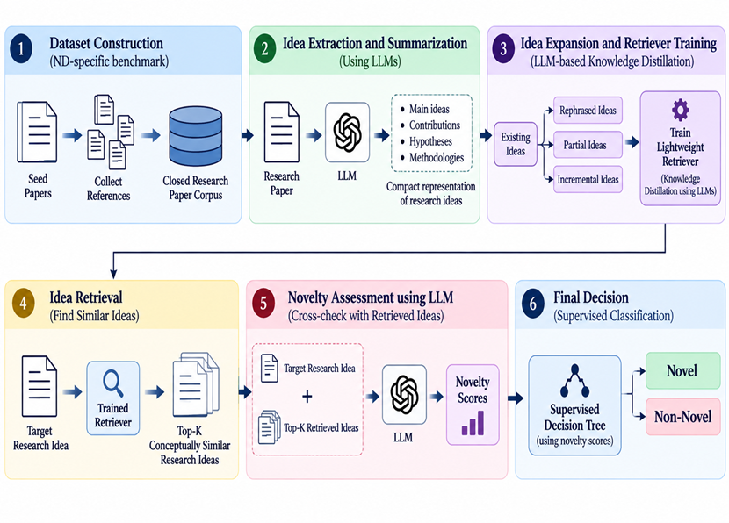
AI-Based Research Paper Novelty Assessment System Using Retrieval-Augmented Generation (RAG)
Guide: Dr. M . Srinivasa Rao
Batch ID: AIML-B06
Regd No#1 23BQ1A61A6, Regd No#2 23BQ1A6171,
Regd No#3 23BQ1A6156, Regd No#4 23BQ1A6158,
Literature Review
Ref 02 – Harnessing Large Language Models for Scientific Novelty Detection
Yan Liu et al., 2025 | arXiv
| Proposed Method | Data & Setup | key Results | Strengths & Limitations | Relevance to my research |
The authors propose an LLM-based framework for Scientific Novelty Detection (ND) that focuses on identifying similarity at the idea level, rather than only comparing text.
First, they construct ND-specific benchmark datasets by selecting seed papers, collecting their references, and forming a closed research-paper corpus.
To improve retrieval, the authors generate rephrased, partial, and incremental ideas from existing ideas.
The trained retriever identifies the Top-K conceptually similar research ideas.
Finally, the LLM assigns novelty scores by comparing the target idea with the retrieved ideas, and a supervised decision tree uses these scores to make the final Novel/Non-Novel decision.

Slide 9
AI-Based Research Paper Novelty Assessment System Using Retrieval-
Augmented Generation (RAG)
Guide: Dr. M . Srinivasa Rao
Batch ID: AIML-B06
Regd No#1 23BQ1A61A6, Regd No#2 23BQ1A6171,
Regd No#3 23BQ1A6156, Regd No#4 23BQ1A6158,
Literature Review
Ref 02 – Harnessing Large Language Models for Scientific Novelty Detection
Yan Liu et al., 2025 | arXiv
| Proposed Method | Data & Setup | key Results | Strengths & Limitations | Relevance to my research |
The study uses two newly created datasets from the Marketing and Natural Language Processing (NLP) research domains.
The Marketing dataset contains seed papers collected from the Journal of Marketing and Journal of Marketing Research, covering publications from 2004 to 2024.
The NLP dataset contains 3,533 papers collected from ACL conferences over the past five years.
References of the seed papers were collected using the Semantic Scholar API, forming a closed research corpus for novelty detection.
LLMs were used to generate rephrased, partial, and incremental ideas as non-novel examples for training the idea retriever.
The experiments use different retriever backbones such as BGE, GTE, E5, SimCSE, SBERT, and NLI, with BGE using LLM-based knowledge distillation selected for the RAG-based novelty detection experiments.

Slide 10
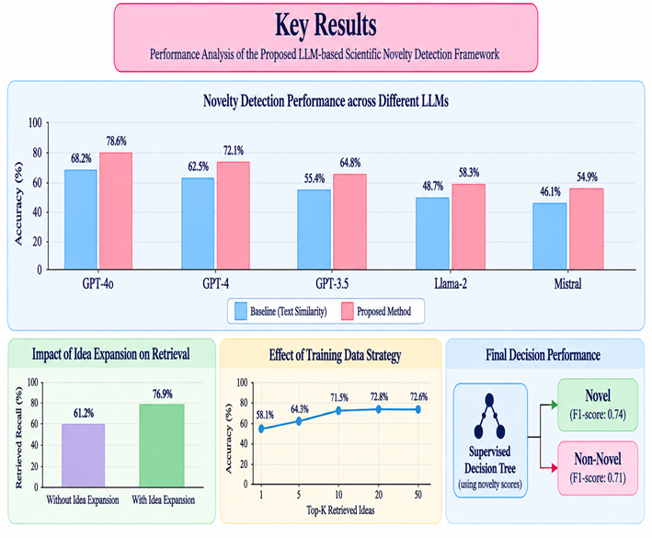
AI-Based Research Paper Novelty Assessment System Using Retrieval-Augmented Generation (RAG)
Guide: Dr. M . Srinivasa Rao
Batch ID: AIML-B06
Regd No#1 23BQ1A61A6, Regd No#2 23BQ1A6171,
Regd No#3 23BQ1A6156, Regd No#4 23BQ1A6158,
Literature Review
Ref 02 – Harnessing Large Language Models for Scientific Novelty Detection
Yan Liu et al., 2025 | arXiv
| Proposed Method | Data & Setup | key Results | Strengths & Limitations | Relevance to my research |
The proposed LLM-based KD retriever consistently performed better than the baseline retrievers in both Marketing and NLP domains.
Compared with the best baseline, the method achieved an average improvement of 5.40% in Marketing and 15.19% in NLP for the idea retrieval task.
In the novelty detection task, RAG-KD outperformed all baseline methods in both Marketing and NLP datasets.
RAG-KD achieved 74.53% accuracy in Marketing and 74.74% accuracy in NLP, showing improvement over the RAG-Vanilla approach.
The experiments showed that using an idea-level retriever is important for novelty detection, and a moderate retrieval size such as Top-5 or Top-10 provided stable performance.

Slide 11
AI-Based Research Paper Novelty Assessment System Using Retrieval-Augmented Generation (RAG)
Guide: Dr. M . Srinivasa Rao
Batch ID: AIML-B06
Regd No#1 23BQ1A61A6, Regd No#2 23BQ1A6171,
Regd No#3 23BQ1A6156, Regd No#4 23BQ1A6158,
Literature Review
Ref 02 – Harnessing Large Language Models for Scientific Novelty Detection
Yan Liu et al., 2025 | arXiv
| Proposed Method | Data & Setup | key Results | Strengths & Limitations | Relevance to my research |
Strengths
Limitations
Idea-level retrieval: The method focuses on conceptual similarity instead of relying only on textual similarity.
LLM-based knowledge distillation: Uses LLM-generated ideas to train a lightweight retriever for more effective idea retrieval.
Strong performance: RAG-KD consistently outperforms baseline methods in both idea retrieval and novelty detection tasks.
LLM-generated data: Generated ideas and novelty scores may not always be accurate or consistent.
Binary classification: The framework currently classifies ideas only as Novel or Non-Novel, although novelty can be continuous and subjective.
Dependence on prompts: Ambiguous or subtle prompts can introduce noise into the generated data and affect retriever training and novelty detection.

Slide 12
AI-Based Research Paper Novelty Assessment System Using Retrieval-
Augmented Generation (RAG)
Guide: Dr. M . Srinivasa Rao
Batch ID: AIML-B06
Regd No#1 23BQ1A61A6, Regd No#2 23BQ1A6171,
Regd No#3 23BQ1A6156, Regd No#4 23BQ1A6158,
Literature Review
Ref 02 – Harnessing Large Language Models for Scientific Novelty Detection
Yan Liu et al., 2025 | arXiv
| Proposed Method | Data & Setup | key Results | Strengths & Limitations | Relevance to my research |
Idea-level similarity: The paper shows that novelty assessment should focus on the research idea and concept, not only on textual similarity.
LLM + RAG: Its combination of an LLM with RAG provides a useful approach for comparing a new research paper with existing literature.
Improved retrieval: The LLM-based knowledge distillation retriever can help our system retrieve papers with similar research ideas, even when their wording is different.
Novelty scoring: The approach of comparing a target idea with retrieved ideas and assigning novelty scores can be adapted to our project.
Basis for our system: This reference supports our proposed system by showing how conceptual retrieval and LLM-based cross-checking can be used together for automated research-paper novelty assessment

Slide 13
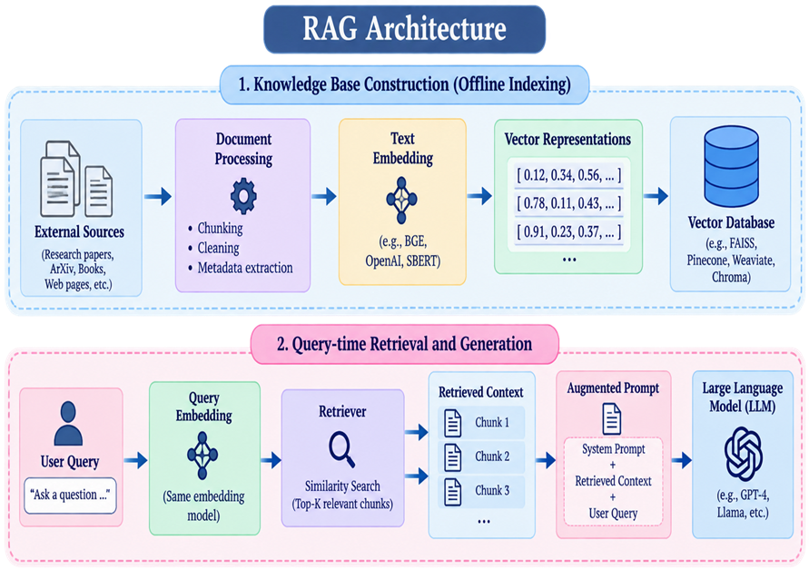
AI-Based Research Paper Novelty Assessment System Using Retrieval-Augmented Generation (RAG)
Guide: Dr. M . Srinivasa Rao
Batch ID: AIML-B06
Regd No#1 23BQ1A61A6, Regd No#2 23BQ1A6171,
Regd No#3 23BQ1A6156, Regd No#4 23BQ1A6158,
Literature Review
Ref 03 – Retrieval-Augmented Generation for Large Language Models: A Survey
Yunfan Gao et al., 2024
| Proposed Method | Data & Setup | key Results | Strengths & Limitations | Relevance to my research |
RAG Framework - The paper presents a systematic framework that combines LLM knowledge with information retrieved from external knowledge sources.
Three Main Components - RAG combines Retrieval, Augmentation, and Generation, where relevant information is retrieved and provided to the LLM.
Retrieval & Generation - Documents are divided into chunks, converted into embeddings, and stored in a vector database. The Top-K relevant chunks are then combined with the original query to create a context-rich prompt for the LLM.
Evolution of RAG - The authors classify RAG into Naive RAG, Advanced RAG, and Modular RAG, with improvements in retrieval, context processing, and system flexibility.

Slide 14
AI-Based Research Paper Novelty Assessment System Using Retrieval-Augmented Generation (RAG)
Guide: Dr. M . Srinivasa Rao
Batch ID: AIML-B06
Regd No#1 23BQ1A61A6, Regd No#2 23BQ1A6171,
Regd No#3 23BQ1A6156, Regd No#4 23BQ1A6158,
Literature Review
Ref 03 – Retrieval-Augmented Generation for Large Language Models: A Survey
Yunfan Gao et al., 2024
| Proposed Method | Data & Setup | key Results | Strengths & Limitations | Relevance to my research |
The survey analyzes more than 100 RAG studies to provide a systematic overview of existing RAG methods and their development.
It organizes RAG research around three major components: Retrieval, Generation, and Augmentation.
The survey considers different types of external knowledge sources, including text, PDF documents, databases, and knowledge graphs.
Different retrieval granularities are discussed, ranging from tokens, sentences, and chunks to complete documents, depending on the application.
For evaluation, the authors summarize 26 downstream tasks and nearly 50 datasets, along with their evaluation objectives and metrics.
The survey also reviews existing benchmarks, evaluation methods, and tools used to measure the performance of RAG systems.

Slide 15
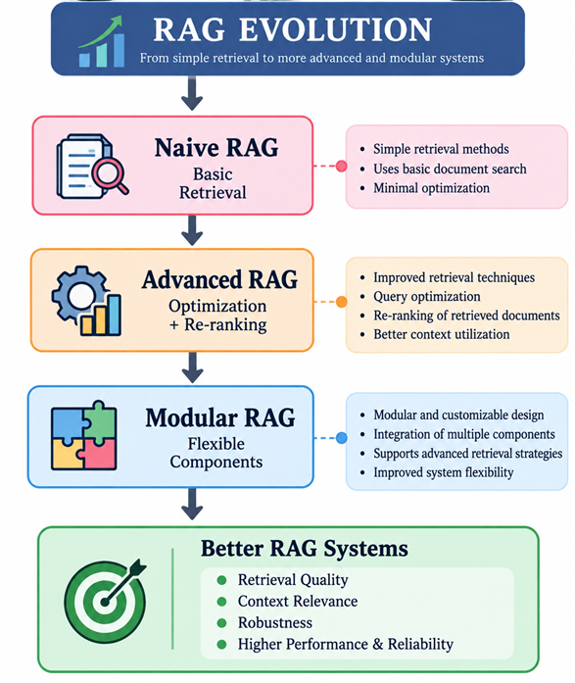
AI-Based Research Paper Novelty Assessment System Using Retrieval-Augmented Generation (RAG)
Guide: Dr. M . Srinivasa Rao
Batch ID: AIML-B06
Regd No#1 23BQ1A61A6, Regd No#2 23BQ1A6171,
Regd No#3 23BQ1A6156, Regd No#4 23BQ1A6158,
Literature Review
Ref 03 – Retrieval-Augmented Generation for Large Language Models: A Survey
Yunfan Gao et al., 2024
| Proposed Method | Data & Setup | key Results | Strengths & Limitations | Relevance to my research |
The survey shows that RAG has developed rapidly from basic retrieval methods to more advanced and flexible architectures.
RAG research is broadly organized into Naive RAG, Advanced RAG, and Modular RAG, with each stage improving retrieval, generation, and system flexibility.
The study finds that retrieval quality is a major factor in overall RAG performance, making indexing, query optimization, embeddings, and re-ranking important.
The survey identifies 26 downstream tasks and nearly 50 datasets, showing that RAG is being applied across a wide range of applications.
The authors highlight evaluation frameworks and tools such as RGB, RECALL, RAGAS, ARES, TruLens, and CRUD for measuring retrieval and generation quality.

Slide 16
AI-Based Research Paper Novelty Assessment System Using Retrieval-Augmented Generation (RAG)
Guide: Dr. M . Srinivasa Rao
Batch ID: AIML-B06
Regd No#1 23BQ1A61A6, Regd No#2 23BQ1A6171,
Regd No#3 23BQ1A6156, Regd No#4 23BQ1A6158,
Literature Review
Ref 03 – Retrieval-Augmented Generation for Large Language Models: A Survey
Yunfan Gao et al., 2024
| Proposed Method | Data & Setup | key Results | Strengths & Limitations | Relevance to my research |
Strengths
Limitations
Comprehensive survey: Reviews over 100 RAG studies and organizes the field into a clear framework.
Wide coverage: Covers Retrieval, Generation, and Augmentation, along with RAG tasks, datasets, benchmarks, and evaluation methods.
Practical guidance: Discusses different RAG approaches, their applications, challenges, and future research directions.
Survey-based study: The paper mainly summarizes existing research and does not propose a new novelty-assessment system.
Rapidly changing field: New RAG techniques and LLM developments can quickly make parts of the survey outdated.
Retrieval challenges: Noise or contradictory information in retrieved documents can negatively affect the generated output.

Slide 17
AI-Based Research Paper Novelty Assessment System Using Retrieval-Augmented Generation (RAG)
Guide: Dr. M . Srinivasa Rao
Batch ID: AIML-B06
Regd No#1 23BQ1A61A6, Regd No#2 23BQ1A6171,
Regd No#3 23BQ1A6156, Regd No#4 23BQ1A6158,
Literature Review
Ref 03 – Retrieval-Augmented Generation for Large Language Models: A Survey
Yunfan Gao et al., 2024
| Proposed Method | Data & Setup | key Results | Strengths & Limitations | Relevance to my research |
RAG framework: The paper provides the basic RAG architecture that can be used to build our research-paper novelty assessment system.
Effective retrieval: Its discussion of document retrieval, embeddings, indexing, and re-ranking helps in selecting relevant research papers for comparison.
Context augmentation: The retrieved research papers can be added as context to the LLM, helping it analyze a new paper using existing literature.
Evaluation methods: The survey provides different RAG evaluation techniques and metrics that can guide the evaluation of our proposed system.
System improvement: The discussed challenges such as retrieval noise, irrelevant information, and robustness can be considered while designing our novelty assessment system.

Slide 18
AI-Based Research Paper Novelty Assessment System Using Retrieval-Augmented Generation (RAG)
Guide: Dr. M . Srinivasa Rao
Batch ID: AIML-B06
Regd No#1 23BQ1A61A6, Regd No#2 23BQ1A6171,
Regd No#3 23BQ1A6156, Regd No#4 23BQ1A6158,
Literature Review - Summary
Reference | Year | Main Idea | Strengths | Limitations
Gao et al. | 2024 | Comprehensive survey of RAG methods and evaluation. | Covers RAG architectures, techniques & benchmarks. | Survey-based; RAG field changes rapidly.
Lin et al. | 2025 | RAG-Novelty for scholarly paper novelty assessment. | Uses retrieved papers as context; strong benchmark. | Mainly uses title, abstract & metadata.
Liu et al. | 2025 | LLM-based idea-level novelty detection using RAG. | Captures conceptual similarity; effective retrieval. | Depends on LLM-generated ideas and prompts.

Slide 19
: AI-Based Research Paper Novelty Assessment System Using Retrieval-Augmented Generation (RAG)
Guide: Dr. M . Srinivasa Rao
Batch ID: AIML-B06
Regd No#1 23BQ1A61A6, Regd No#2 23BQ1A6171,
Regd No#3 23BQ1A6156, Regd No#4 23BQ1A6158,
Review – 1
Questions?

